Slide 1

Entrepreneurship Definition, Characteristics, relevance
Dr. EYONG AYUK
(PhD TTP. M.A. BSc.)

Slide 2
Entrepreneurship has become increasingly important for businesses of all sizes around the world.
It opens new opportunities and possibilities for the businesses to create values for themselves and for the society at large.
Despite its popularity, studies suggest that the scope of entrepreneurship remains unknown, and therefore the prospects of entrepreneurial activities remains not fully realised.
This chapter highlights some aspects concerning the concept of entrepreneur, entrepreneurship, entrepreneurial process and finally the entrepreneurship opportunities and challenges.

Slide 3

Who is an Entrepreneur............

Slide 4
The term 'Entrepreneur' -French word 'Entreprendre’ (meaning to undertake certain activities)
The usage of the term entrepreneur can be traced from 1755, wherein an entrepreneur was described to “buy the country produce from those who bring it or to order it to be brought on their account. They pay a certain price to resell wholesale or retail at an uncertain price” (Cantillon, 1931, p.51; Hamilton & Harper, 1994)
Entrepreneur from the very beginning, was principally an independent speculator of the commodity (Hamilton & Harper, 1994)

Slide 5
In the modern day markets, the term entrepreneur is closely linked with economic development.
An economic development can emerge due to several reasons, which includes:
the launch of new source of procurement for raw materials or materials
(b) the introduction of a new production mechanism
(c) the introduction of a new quality of product, or a novel product

Slide 6
(d) the opening of new market
(e) the re-organisation of a business.
The management of all these aspects are carried by an enterprise, and the people whose functions are to carry out these activities are called entrepreneurs (Bull & Willard, 1993)

Slide 7
Produces a product
Sells & market the product
Bear overheads like :-
Pays rent of Land and building
wages to labor
interest on capital
later generate profit

Slide 8
In contemporary markets, entrepreneur act as:
innovators or developers who identify and capture opportunities
transform the opportunities into merchandisable concepts
create value through multiple stakeholders and resources
take risks whilst seeking rewards for their ventures and efforts (Kuratko, 2016)

Slide 9
DEFINITIONS
Entrepreneur is someone who manages all the necessary resources to produce and market a product which responds to the market scarcity (Leibenstein, 1968; Bull & Willard, 1993).
“Entrepreneurs are individuals who recognize opportunities where others see chaos contradiction, and confusion. They are aggressive catalysts for change within the marketplace” Kuratko (2016, p.3)
“Entrepreneur is the person who carries out new combinations, causing discontinuity. The role is completed when the function is completed. The person may be an employee with an existing organisation or may start a new venture. An investor per se only risks capital for a return.” Bull & Willard (1993, p. 186)

Slide 10
Working Definition
An entrepreneur is a person who combines various factors of production, processes raw material, converts the raw material into a finished product and creates utility and sells the produce in the market to earn profit.
ENTREPRENEURS ARE MADE AND NOT BORN.

Slide 11
TRAITS OF AN ENTREPRENEUR
Risk takers
Flexible
Knowledgeable
Independent
Energetic
Creative
Dynamic leader
Responsive to suggestions or criticisms
Resourceful
Initiators
Persistent

Slide 12
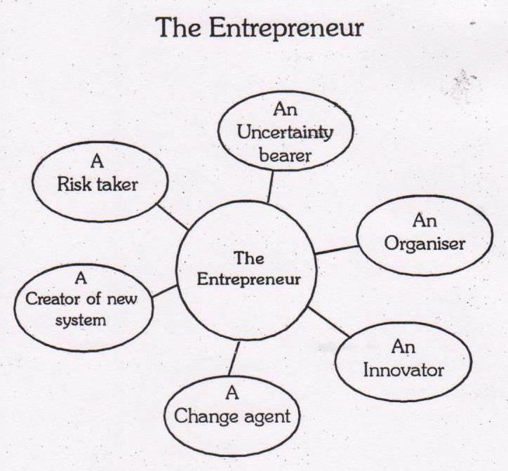

Slide 13
DESCRIPTION OF ENTREPRENEURSHIP
Entrepreneurship is an “act of establishing a new venture” Christensen et al, (2000, p.4)
Entrepreneurship can also be considered as the function through which growth and development can be achieved without commencing a new business venture. It offers a process by which people either inside the companies or on their own, look for prospects without regard to the resources they presently control (Stevenson et al, 1989; Stevenson & Jarillo, 1990).
However, “an entrepreneurial organisation is that which pursues opportunity, regardless of resources currently controlled” Stevenson & Jarillo (1990, p.23).

Slide 14
ENTERPRISE :
Entrepreneurial activity, especially when accompanied by initiative and resourcefulness.

Slide 15
ENTREPRENEURSHIP may be defined in various ways, but the four key elements involved in it are:
Innovation.
Risk-taking.
Vision.
Organizing skill.
The capacity and willingness to develop, organize and manage a business venture along with any of its risks in order to make a profit. The most obvious example of entrepreneurship is the starting of new businesses.

Slide 16
Types of Participants
DOERS : Achievers
DREAMERS : Doing something but not their dream project
DWADLERS : Undecided
DUDS : Abandoned their ideas of being entrepreneur

Slide 17
Entrepreneurial Characteristics
Being an entrepreneur requires specific characteristics and skills that are often achieved through education, hard work, and planning.
Risk Taker
Businesses face risk. Entrepreneurs minimize risk through research, planning, and skill development.
Perceptive
Entrepreneurs view problems as opportunities and challenges.
Curious
Entrepreneurs like to know how things work. They take the time and initiative to pursue the unknown.

Slide 18
Entrepreneurial Characteristics
Imaginative
Entrepreneurs are creative. They imagine solutions to problems that encourage them to create new products and generate ideas.
Persistent
True entrepreneurs face bureaucracy, make mistakes, receive criticism, and deal with money, family, or stress problems. But they still stick to their dreams of seeing the venture succeed.
Goal-setting
Entrepreneurs are motivated by the excitement of staring a new business. Once achieved, they seek out new goals or ventures to try.

Slide 19
Entrepreneurial Characteristics
Self-confident
Entrepreneurs believe in themselves. Their self-confidence takes care of any doubts they may have.
Flexible
Entrepreneurs must be flexible in order to adapt to changing trends, markets, technologies, rules, and economic environments.
Independent
An entrepreneur’s desire for control and the ability to make decisions often makes it difficult for them to work in a controlled environment.
Hardworking
Entrepreneurs need a great deal of energy to see a venture start and succeed. Yet they are not deterred by the long hours to achieve their goal.

Slide 20
Stages of Entrepreneurship
Stage One – The Dreamer.
This is where the idea for a business is born. The dream is the culmination of the entrepreneur’s life experiences and passions.
Stage Two – The Architect.
This stage is where the dream is interpreted into a business model which becomes the blueprint of the venture. The Dreamer typically does not make a good Architect.

Slide 21
Stage Three – The Builder.
This is the stage where the dream can first become reality. The Builder then literally turns the dream into reality. We are now at a critical juncture of the venture.
Stage Four – The Cultivator.
This is the growth stage. Once the business is launched the Cultivator’s primary role is to guide the business through the various levels of growth.

Slide 22
Classification of Entrepreneur
Innovative entrepreneur : -
Such entrepreneurs introduce new goods or new methods of production or discover new markets or reorganize the enterprise. Examples of first movers include innovative companies such as eBay and Coca-Cola. eBay was the first company to take the auction process online, kicking off operations in 1995.
Imitative or adoptive entrepreneur :-
Such entrepreneurs don’t innovate, they copy technology or technique of others.. Such entrepreneurs are significant for under-developed economies because they put such economies on high rate of economic development`EX: Chinese mobiles.

Slide 23
Prime mover :-
This entrepreneur sets in motion a powerful sequence of development expansion and diversification of business. EX: Ambani
Manager :-
Such an entrepreneur doesn’t initiate expansion and its content in just staying in business.
The artists:-
Are highly creative type, very conscious about business.
EX: Aamir Khan, Michael Dell (Dell), Deep Kalra (Make my trip)
The visionary:-
Too focused on dreams with little focused on reality.
EX: Jack Welch(GE), Bill Gates (Microsoft), Kishore Biyani(Future Group), Warren Buffet (Berkshire Hathaway), Sam Walton(Wall Mart).

Slide 24
There are generally four entrepreneurial types
Achievement entrepreneur
Salesman entrepreneur
Technology entrepreneur
Manager

Slide 25
Salesman entrepreneur:
These individuals possess skills to interact with people and have very good soft side of the management aspects.
These people are typified for having the feelings of the consumers’ needs and wants.
They usually use the soft sales approach whilst pursuing the growth of their ventures.
They have enormous talent for connecting with people and spend most of their time in marketing their products/services and permit other people to manage their businesses.
These individuals therefore devote their time to understand who and how are the consumers in the market.
They develop a proper vision for marketing and sales practices to reach wider consumer groups. (Carsrud & Brannback, 2007).

Slide 26
Achievement entrepreneur
Primarily associated with the desire to achieve.
These types of individuals are usually having an enormous amount of energy and capabilities to take charge.
They take initiatives and do not wait for things to happen.
They often possess the leadership qualities and have a great sense of commitment and responsibility in their ventures.
These types of individuals are good in several in several business related aspects and they try to accomplish their objectives, whilst heading their missions. (Carsrud & Brannback, 2007).

Slide 27
Technology entrepreneur:
Individuals belong to this category, are generally idea developers.
These individuals often possess great ideas
They have the capabilities to develop innovative processes and invent novel products or services for niche markets.
As these individuals possess qualities to create several ideas they have a good analytical intelligence and take calculated risks in their ventures
Although these individuals possess good analytical intelligence to make way through several situations, however, at times their missions can become a bit idealistic. (Carsrud & Brannback, 2007).

Slide 28
Manager:
These types of individuals possess the qualities of taking charge of the missions.
Individuals belonging to this type of entrepreneurship are very competitive by nature but not as co-operative as one would expect in a team work.
They are usually found to take positions of high authority, such as external investors or sometimes act as board of directors.
They prefer to work in larger organisations than small entrepreneurial businesses.
They seek comfort in making effective marketing strategies, but not necessary selling products or services.
Their ways to sell are different, they employ logic and carefully thought persuasions, as mechanisms to sell their ideas.
They have rich experiences, strong management skills and possess strength in managing existing businesses (Carsrud & Brannback, 2007).

Slide 29
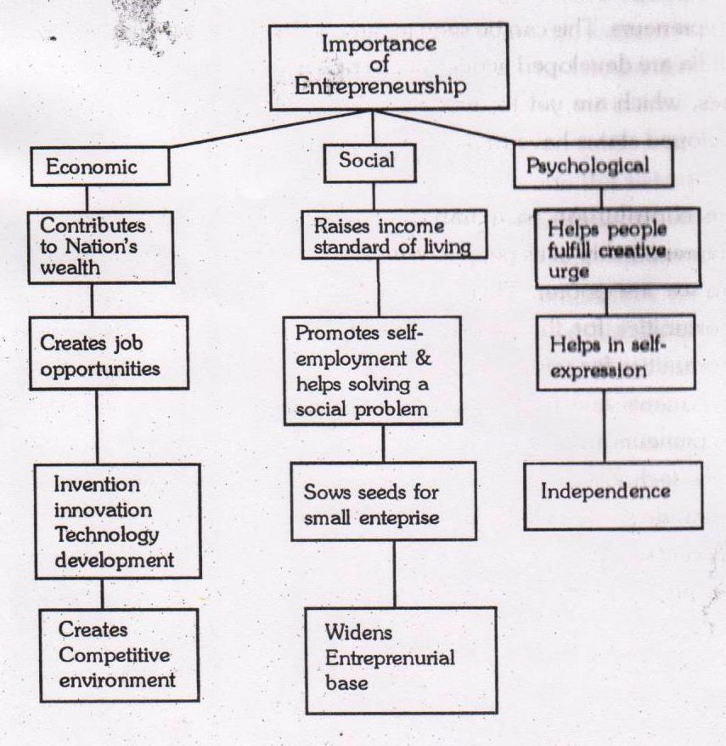

Slide 30
Enrepreneurship Process
The process of entrepreneurship can be observed through the six-stage process:
Identify an opportunity
Establish a vision
Persuade others
Gather resources
Create new venture, product or market
Change/adapt with time

Slide 31
Problems of Entrepreneurship Development Programmes (EDPs) are:
No Policy at the National Level. Though Government of India is fully aware about the importance of entrepreneurial development, yet we do not have a national policy on entrepreneurship. It is expected that the government will formulate and enforce a policy aimed at promoting balanced regional development of various areas through promotion of entrepreneurship.
2. Problems at the Pre training Phase. Various problems faced in this phase are — identification of business opportunities, finding & locating target group, selection of trainee & trainers etc.

Slide 32
3. Over Estimation of Trainees. Under EDPs it is assumed that the trainees have aptitude for self employment and training will motivate and enable the trainees in the successful setting up and managing of their enterprises. These agencies thus overestimate the aptitude and capabilities of the educated youth. Thus on one hand the EDPs do not impart sufficient training and on the other financial institutions are not prepared to finance these risky enterprises set up by the not so competent entrepreneurs.
4. Duration of EDPs. An attempt is made during the conduct of EDPs to prepare prospective entrepreneurs thoroughly for the various problems they will be encountering during the setting up and running of their enterprises. Duration of most of these EDPs varies between 4 to 6 weeks, which is too short a period to instill basic managerial skills in the entrepreneurs. Thus the very objective to develop and strengthen entrepreneurial qualities and motivation is defeated.

Slide 33
5. Non Availability of Infrastructural Facilities. No prior planning is done for the conduct of EDPs. EDPs conducted in rural and backward areas lack infrastructural facilities like proper class room suitable guest speakers, boarding and lodging etc.
6. Improper Methodology. The course contents are not standardized and most of the agencies engaged in EDPs are themselves not fully clear about what they are supposed to do for the attainment of pre-determined goals. This puts a question mark on the utility of these programmes.

Slide 34
Need of Entrepreneurship
Increases national production
Balanced area development
Dispersal of economic power
Reinvestment of profit for the welfare of the area of profit generation
Development is a function of motivation and human resource
Entrepreneurial awareness
Development is a function of motivation and human resource
Entrepreneurial awareness
Aim to create employment opportunities, and generate wealth at an incremental and sustainable rate.

Slide 35
Steps to Promote Entrepreneurship
Setup Entrepreneurial Development Institutes in every state.
Recognize and celebrate entrepreneurship among youth as a preferred career.
Enhance access to finance for start-ups in every possible way.
Reduce the time of starting a business and ease down the complex procedures of Govt licensing and other such activities like finance and banking etc.
Promote entrepreneurship among women and other underprivileged.

Slide 36

Every Big Enterprises Starts with a small Dream
So Keep Dreaming ……………………

